Slide 1
Artificial Intelligence
Fuzzy Expert System
Artificial Intelligence, Lecturer #07

Slide 2
Contents
Expert system
  Rule-Based Expert System
  Frame-Based Expert System
  Fuzzy Expert System
Artificial Intelligence, Lecturer #07

Slide 3
Introduction: Fuzzy Expert System
An expert might say, “ Though the power transformer is slightly overloaded, I can keep this load for a while.
Another expert in the same domain can understand it.
But, a knowledge engineer would have difficulties, providing a computer with the same level of understanding.
How can we represent expert knowledge that use vague and ambiguous terms in computer?
Artificial Intelligence, Lecturer #07

Slide 4
Fuzzy Expert System
An expert system that uses fuzzy logic instead of Boolean logic is known as Fuzzy expert system.
A fuzzy expert systems is collection of fuzzy rules and membership functions that are used to reason about data.
Artificial Intelligence, Lecturer #07

Slide 5
Introduction: Fuzzy Expert System
Fuzzy logic is a logic that describes fuzziness. As fuzzy logic attempts to model human’s sense of words, decision making and common sense, it is leading to more human intelligent machines.
Fuzzy logic was introduced in the 1930 by Jan Lukasiewicz, a Polish Philosopher (extended the truth values between 0 to 1).
Later, 1937 Max Black define first sample fuzzy set.
In 1965, Lotif Zadeh rediscovered fuzziness, identified and explored it.
Artificial Intelligence, Lecturer #07

Slide 6
Fuzzy Logic?
Fuzzy logic is a set of mathematical principles for knowledge representation based on degrees of membership rather than the crisp membership of classical binary logic.
Unlike two-valued Boolean logic, fuzzy logic is multi valued.
0
0
0
1
1
1
0
0
0.2
0.4
0.6
0.8
1
1
Boolean Logic
Multivalued Logic
Artificial Intelligence, Lecturer #07

Slide 7
Fuzzy Set?
Classical set theory is governed by a logic that uses one of only two values: true and false.
The basic idea of fuzzy set theory is that an element belongs to a fuzzy set with a certain degree of membership. Thus a proposition is not either true or false.
Artificial Intelligence, Lecturer #07

Slide 8
Fuzzy Set?
Classical set theory imposes a sharp boundary on this set and gives each member of the set the value of 1, and all members that are not within the set a value of 0. This is known as the principle of dichotomy.
Consider following classical paradox:
The barber of a village gives a hair cut only to those who do not cut their hair themselves.
  Question: Who cut the barber hair?
  Boolean logic: This assertion contains a contradiction.
  Fuzzy logic: The barber cuts and doesn’t cut his own hair
Artificial Intelligence, Lecturer #07

Slide 9
Example of Fuzzy Set Theory?
Degree of Membership of “tall men”
Name | Height (cm) | Degree of membership
 |  | Crisp | Fuzzy
Rahim | 208 | 1 | 1.00
Karim | 205 | 1 | 1.00
Ram | 198 | 1 | .98
Sam | 181 | 1 | .82
Jodu | 179 | 0 | .78
Modu | 172 | 0 | 0.24
Abdul | 167 | 0 | 0.15
Anis | 158 | 0 | 0.06
Montu | 155 | 0 | 0.01
Robin | 152 | 0 | 0.00
Artificial Intelligence, Lecturer #07

Slide 10
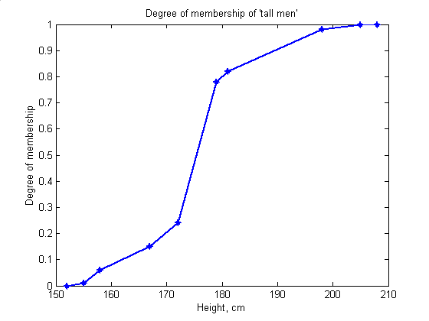
Degree of Membership of ‘Tall Men’
Red line for ‘Crisp’ sets and Blue line for ‘Fuzzy’ sets of tall men
Artificial Intelligence, Lecturer #07

Slide 11
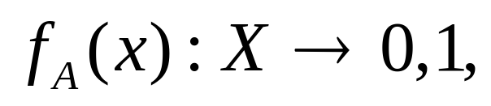
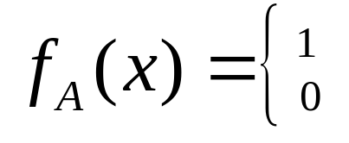
What is a Fuzzy Set?
A fuzzy set is is defined as a set with fuzzy boundaries.
Let X be the universe of discourse and its elements be denoted as x.
In classical set theory, crisp set A of X is defined as function f_{A}(x) called the characteristic function of A.
If x Є A
If x Є A
Artificial Intelligence, Lecturer #07

Slide 12
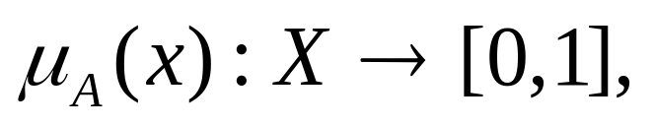
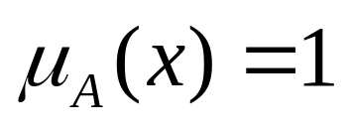
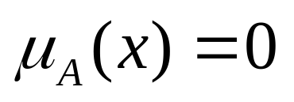
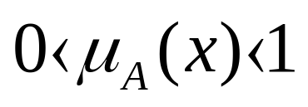
What is a Fuzzy Set?
In the fuzzy theory, fuzzy set A of universe X is defined by the function μ_{A}(x) called the membership function of set A.
If x is totally in A;
If x is not in A;
If x is partly in A;
Artificial Intelligence, Lecturer #07

Slide 13
Fuzzy Rule?
A conditional statement in the form: If x is A; then y is B, Where x and y are linguistic variables and A & B are linguistic values determined by fuzzy sets.
Examples:
Rule1:
If Speed is fast
Then stopping_distance is long
Rule 2:
If Speed is slow
Then stopping_distance is short
Artificial Intelligence, Lecturer #07

Slide 14
Fuzzy Inference
Fuzzy inference is a process of mapping from a given input to an output by using the theory of Fuzzy sets.
The process of reasoning based on fuzzy logic.
Fuzzy inference includes four steps: (Prof. Ebrahim Mamdani 1975)
  Fuzzification of the input variables
  Rule evaluation
  Aggregation of the rule outputs
  Defuzzification
Artificial Intelligence, Lecturer #07

Slide 15
Examples: Fuzzy Inference
(2 input 1 output problem)
Rule1: If x is A3 OR y is B1 Then z is C1 | Rule1: If project_funding is adequate OR project_staffing is small Then risk is low
Rule2: If x is A2 AND y is B2 Then z is C2 | Rule2: If project_funding is marginal AND project_staffing is large Then risk is normal
Rule3: If x is A1 Then z is C3 | Rule3: If project_funding is inadequate Then risk is high
Artificial Intelligence, Lecturer #07

Slide 16
Fuzzification
The first step of fuzzy inference; the process of mapping crisp (numerical) inputs into degrees to which these inputs belong to respective fuzzy sets.
Example: Membership function of project_stuffing is small (B1) and large (B2) to the degree of 0.1 and 0.7.
Artificial Intelligence, Lecturer #07

Slide 17
Rule Evaluation
The second step is to take the fuzzified inputs, μ_{(x=A1)}=0.5, μ_{(x=A2)}=0.2, μ_{(y=B1)}=0.1 and μ_{(y=B2)}=0.7, and apply them to the antecedents of the Fuzzy rules.
Example:
Rule1:
If x is A3 (0.0)
OR y is B1 (0.1)
Then z is C1 (0.1)
μC1(z)=max[μA3(x), μB1(y)]=max[0.0, 0.1]=0.1
Rule2:
If x is A2 (0.2)
AND y is B2 (0.7)
Then z is C2 (0.2)
μC2(z)=min[μA2(x), μB2(y)]=min[0.2, 0.7]=0.2
Artificial Intelligence, Lecturer #07

Slide 18
Aggregation
The result of the antecedent evaluation can be applied to the membership function of the consequent.
Aggregation is the process of unification of the outputs of all rules.
Artificial Intelligence, Lecturer #07

Slide 19
Defuzzification
The last step in the fuzzy inference process is defuzzification.
The input for the defuzzification process is the aggregate output fuzzy set and the output is a single number.
Example: Risk is 67.4%
Artificial Intelligence, Lecturer #07

Slide 20
Recommended Textbooks
[Negnevitsky, 2001] M. Negnevitsky “ Artificial Intelligence: A guide to Intelligent Systems”, Pearson Education Limited, England, 2002.
[Russel, 2003] S. Russell and P. Norvig Artificial Intelligence: A Modern Approach Prentice Hall, 2003, Second Edition
[Patterson, 1990] D. W. Patterson, “Introduction to Artificial Intelligence and Expert Systems”, Prentice-Hall Inc., Englewood Cliffs, N.J, USA, 1990.
[Lindsay, 1997] P. H. Lindsay and D. A. Norman, Human Information Processing: An Introduction to Psychology, Academic Press, 1977.
Artificial Intelligence, Lecturer #07

Slide 21
End of Presentation
Question/Suggestions?
Thanks to all !!!
Artificial Intelligence, Lecturer #07

